Slide 1

Geonovum
Verkent, verbindt, verankert
Ine de Visser

Slide 2
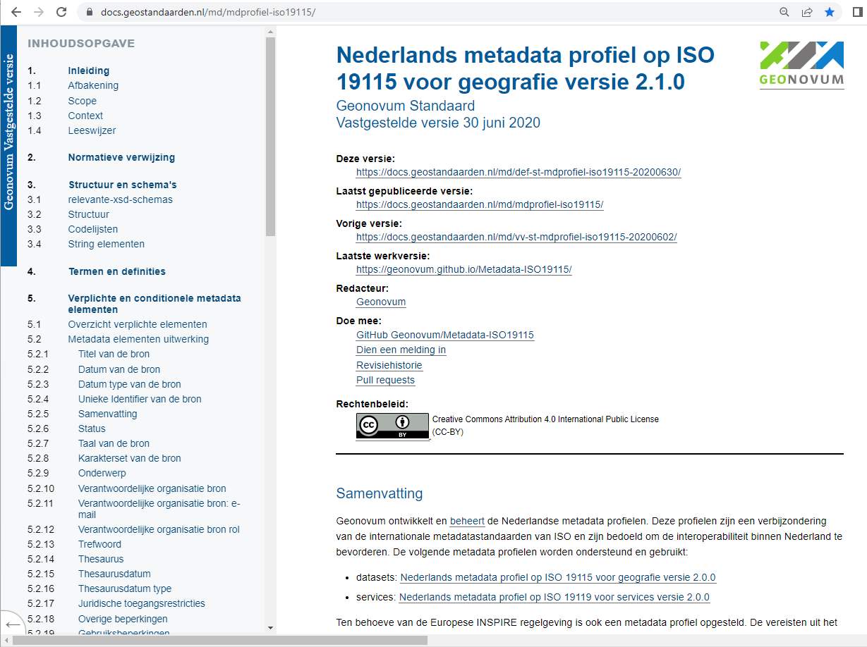
Dutch metadata profile

Slide 3
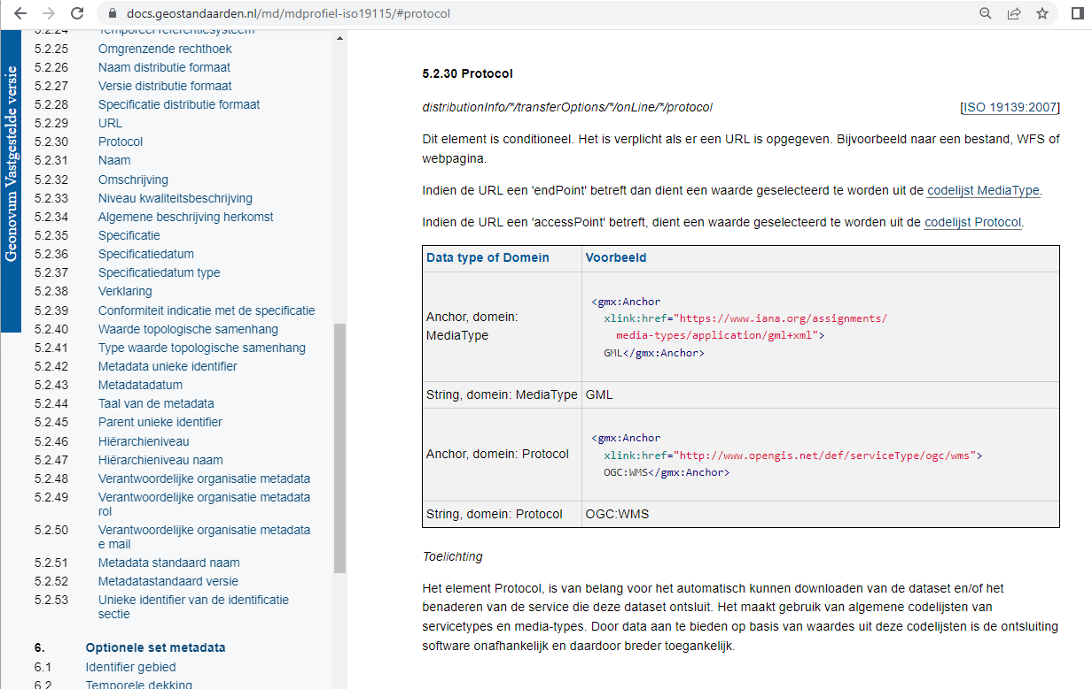
Protocol element

Slide 4
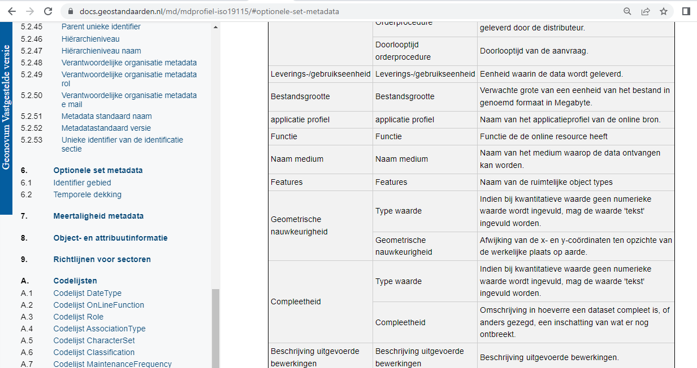
Optional application profile element

Slide 5
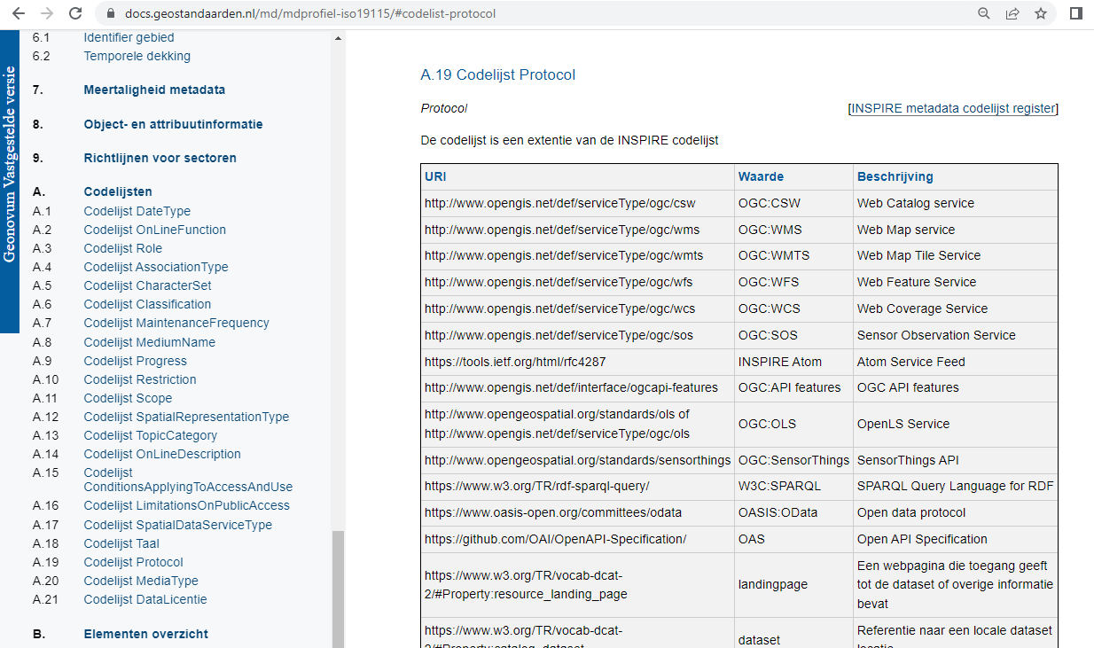
Protocol codelist

Slide 6
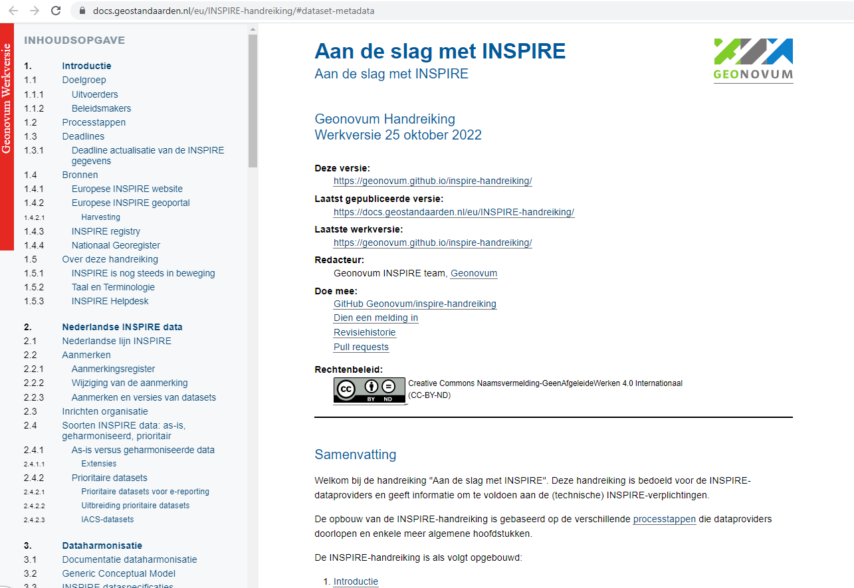
Dutch INSPIRE guide

Slide 7
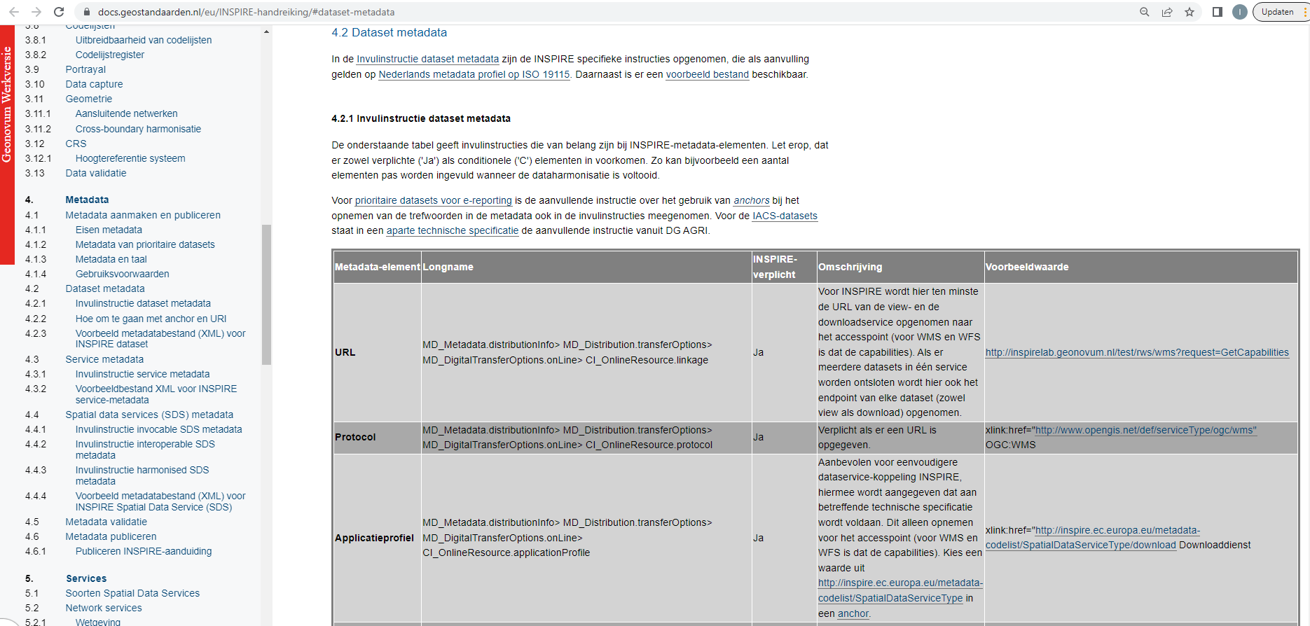
Instructions data service linking

Slide 8
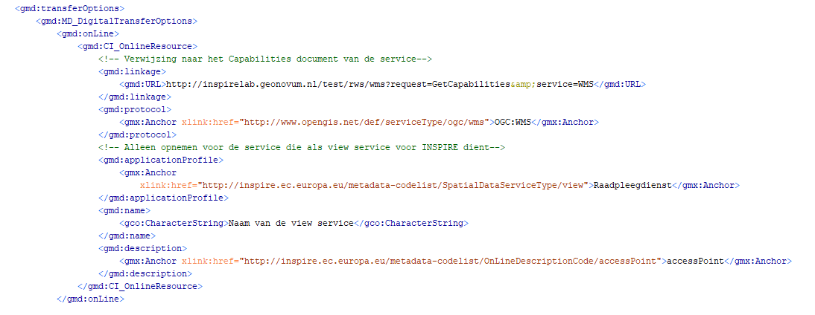
XML example

Slide 9
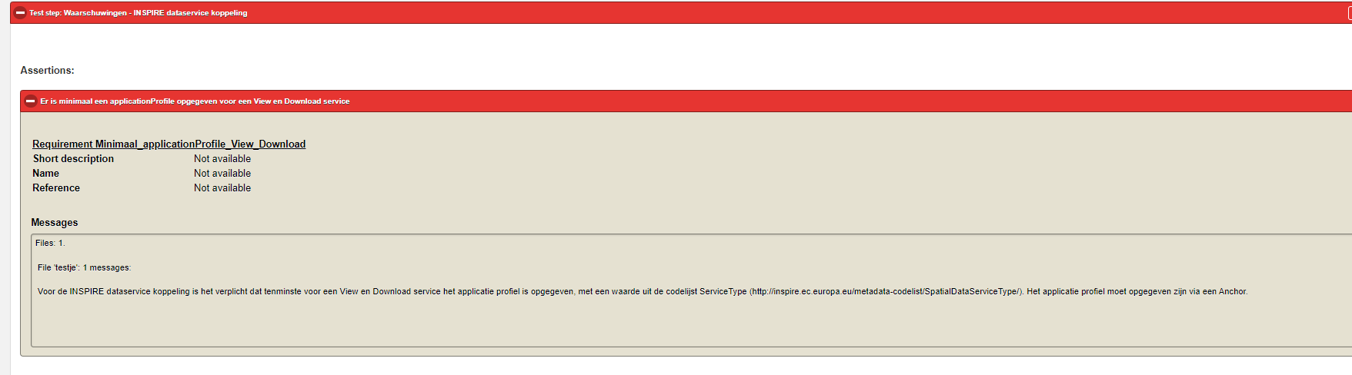
Validation warnings data service linking

Slide 10
Bedankt!

